Slide 1
Root directory of virtual environment
The virtual environment of python Django web site
0
C:\venvs
1
python -m venv mysite
2
C:\venvs\mysite\Scripts\activate.bat
Get into “virtual environment. Then install Django
TEST: Web site running without app creation
At this point, you can open them with editor such as pycharm, vscode etc. NOTE: do not forget to set “virtual environment” of python on your ide
python manage.py runserver
virtual environment
Virtual Environment
3
Pip install django
Confirm: pip freeze: compare
Folder “projects/mysite/appName” will be created via…
Django site creation
Main Web Project
5
Web Site
Create Project folder: “projects/mysite”
Run Django site
7
6
App
App
django-admin startproject config .
App
django-admin startapp appName
8
Config/urls.py
9
python manage.py runserver
Config/settings.py
Run it on browser
Get into “virtual environment.
4
project
Project folder: “projects”
10
http://localhost:8000/appName
NOTE: Under project folder, get into “virtual” environment. Then do process #5. #5 can be skipped and “Django-admin startproject”, but it generates folder a bit weird.
INSTALLED_APPS section: Register App you have created on #7 process

Slide 2
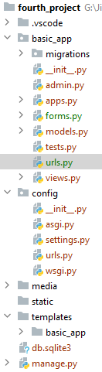
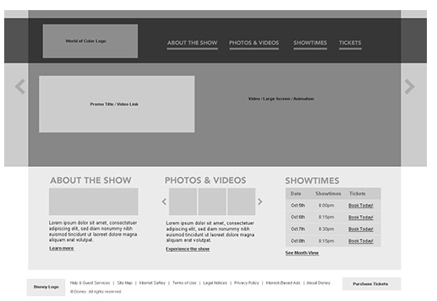
0
Python Django Web Project and App Structure
Settings
$ python manage.py --help
Type 'manage.py help <subcommand>' for help on a specific subcommand.
Available subcommands:
[auth]
changepassword
createsuperuser
[contenttypes]
remove_stale_contenttypes
[django]
check
compilemessages
createcachetable
dbshell
diffsettings
dumpdata
flush
inspectdb
loaddata
makemessages
makemigrations
migrate
sendtestemail
shell
showmigrations
sqlflush
sqlmigrate
sqlsequencereset
squashmigrations
startapp
startproject
test
testserver
[sessions]
clearsessions
[staticfiles]
collectstatic
findstatic
runserver
Web Project
1
Web project
Web Project Routing
App
ORM
App
2
App
App Routing
app
admin
6
Built-In Authentication
form
MTV Pattern
model
3
DB
view
4-2
App routing
Controller
view
Form
4-1
4
5
html
5-1
Settings
model
template html
Web project routing
static
Css, Js, Image, etc
data
presentation
static
Template html
User Defined Data
ORM: Code First
DB
Python command
python manage.py makemigrations
python manage.py migrate
Ref: https://docs.djangoproject.com/en/3.0/ref/models/fields/#field-types
Ref: https://docs.djangoproject.com/en/3.0/topics/db/queries/
Ref: https://docs.djangoproject.com/en/3.0/topics/templates/
Ref: https://docs.djangoproject.com/en/3.0/topics/forms/

Slide 3
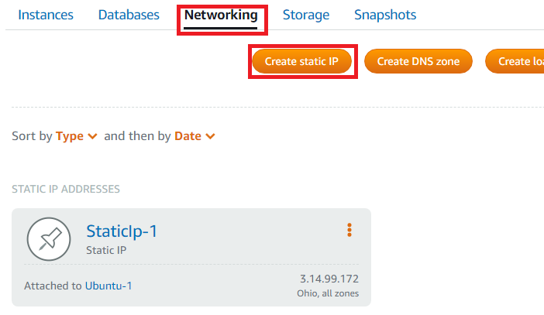
Deployment to Amazon Cloud – LightShell : lightsail.aws.amazon.com
terminal
1. >> sudo ln -sf /usr/share/zoneinfo/America/Toronto /etc/localtime
2. >> date
3. >> python
(error. instead...)
4. >> python3
5. >> sudo apt update
6. >> sudo apt install --only-upgrade python3
(upgrade python)
7. >> python3 --version
8. >> sudo apt install python3-venv or >> sudo apt install python3.8-venv
(python3 venv package)
9. >> mkdir projects
10.>> mkdir venvs
11. >> cd venvs and >> python3 -m venv mysite
(create virtual environment under mysite)
12. >> cd bin and >> . activate (or source activate)
(get into virtual enrionment)
13. >> pip install django
14. >> pip install markdown
15. >> cd ~/projects
16. >> git clone -b master https://github.com/jinibyun/Python_pybo.git mysite
17. >> cd mysite
18. >> source venvs/mysite/bin/activate
(get into virtual environment)
19. (under ~/projects/mysite) python manage.py runserver
20. In order to create "static" ip address -->> amazon lightShell Dashboard > Network
e.g. 3.14.99.172

Slide 4
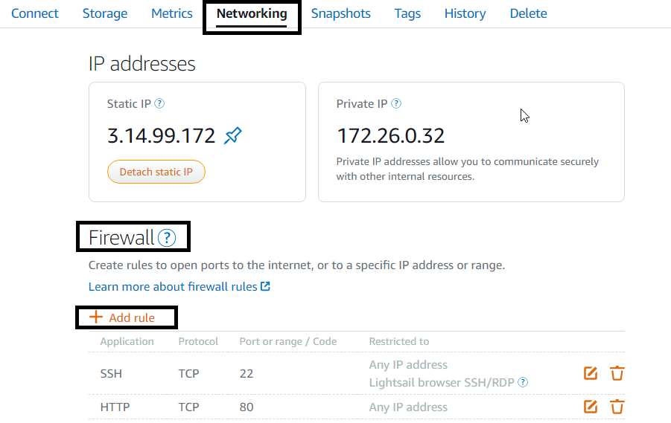
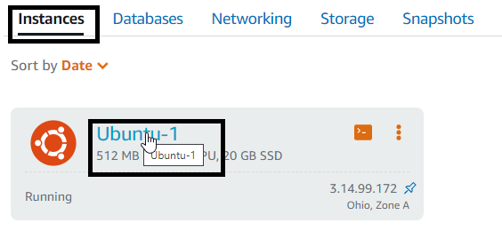
Deployment to Amazon Cloud – LightShell : lightsail.aws.amazon.com
21. Firewall
Dashboard > instance click > networking > firewall > + add rule > add 8000 TCP > create
22. >> python manage.py runserver 0:8000
NOTE: watching for file changes with statreloader
performing system checks....
...
...
Error: That port is already in use
(If we encounter error message...then) >> killall python
23. open browser: 3.14.99.172:8000
24. error message
"Invalid HTTP_HOST header: '3.14.99.172:8000'. You may need to add '3.14.99.172' to ALLOWED_HOSTS."
25. In Local, change settings.py
ALLOWED_HOSTS = ['3.14.99.172']
and commit and push
26. On amazon terminal,
>> git pull
(or to skip authentication, git config credential.helper store)
27. >> python manage.py runserver 0:8000
28. open browser: 3.14.99.172:8000

Slide 5
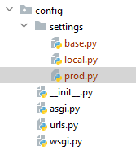
Deployment to Amazon Cloud – LightShell : lightsail.aws.amazon.com
Settings.Py Configruation for both local an server
(NOTE) We set ALLOWED_HOSTS = ['3.14.99.172’]. This should be split for both environment
(Local Terminal)
Terminal
projects\mysite\config>
>> mkdir settings
2. >> move settings.py settings/base.py
(NOTE settings.py is renamed to base.py)
3 change base.py
BASE_DIR = Path(__file__).resolve().parent.parent.parent
4. Create “local.py” under \mysite\config\settings\
from .base import *
ALLOWED_HOSTS = []
5. Create “prod.py” under \mysite\config\settings\
from .base import *
ALLOWED_HOSTS = [‘3.14.99.172’]
6. Confirmation
7. >> python manage.py runserver
(Error) ……..The SECRET_KEY setting must not be empty…….
(Reason) Settings.py is removed
8. >> python manage.py runserver --settings=config.settings.local
(When run it on Local Environment)
9. >> python manage.py runserver --settings=config.settings.prod
(When run it on Prod Environment)
10. >> git commit -a -m "change config“
11. >> git push

Slide 6
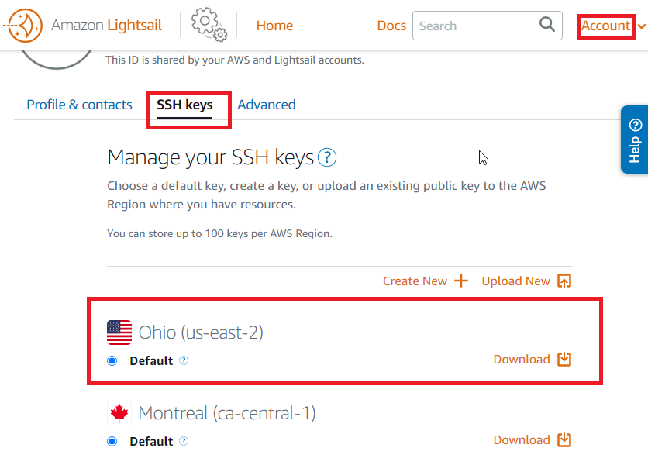
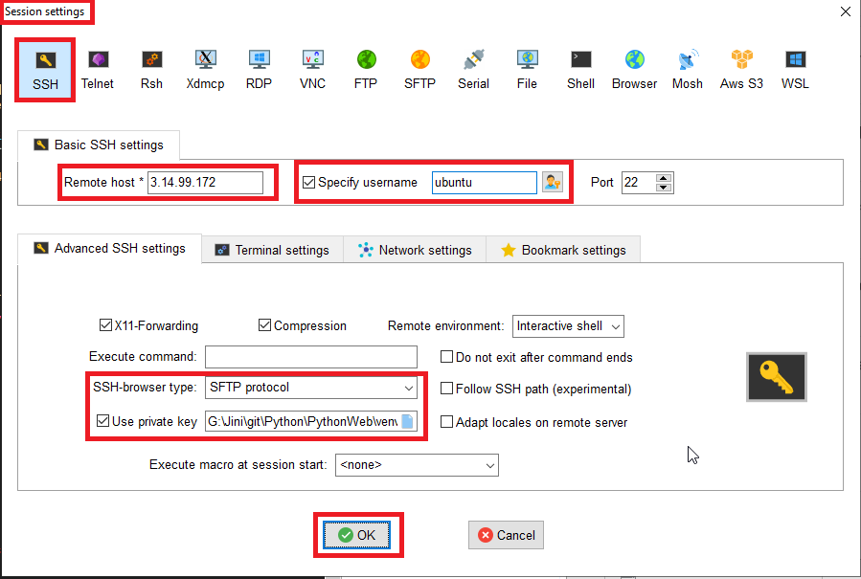
Deployment to Amazon Cloud – LightShell : lightsail.aws.amazon.com
Terminal Program Instead of AWS web terminal
(NOTE) We need private key
1. Download it under venvs directory in the name of “mysite.pem”
2. You can use any terminal program.
https://mobaxterm.mobatek.net/download.html
3. Follow below instruction to connect

